Slide 1
JOURNEY SCRAPBOOK
CUSTOM TRAINING
25-09-2023 to 29-09-2023
Purushottam Behera
Batch-4

Slide 2
Agenda week-6
PySpark
Databricks – 1
Databricks – 2
Azure Containers
Azure Deployment / Devops

Slide 3
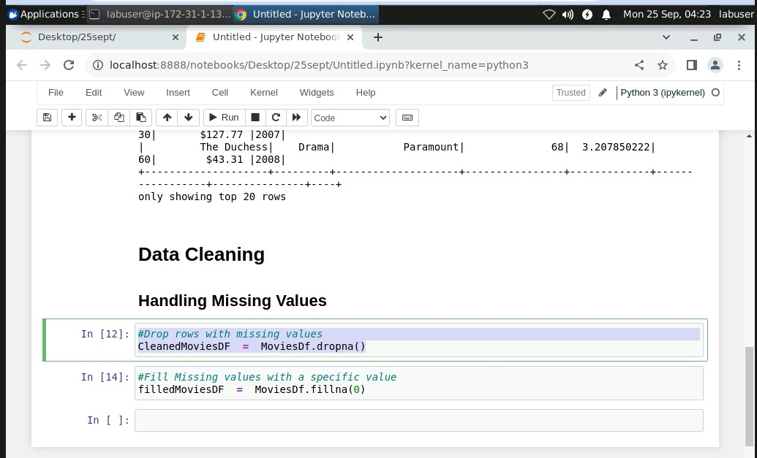
Day – 1 ( PySpark )

Slide 4
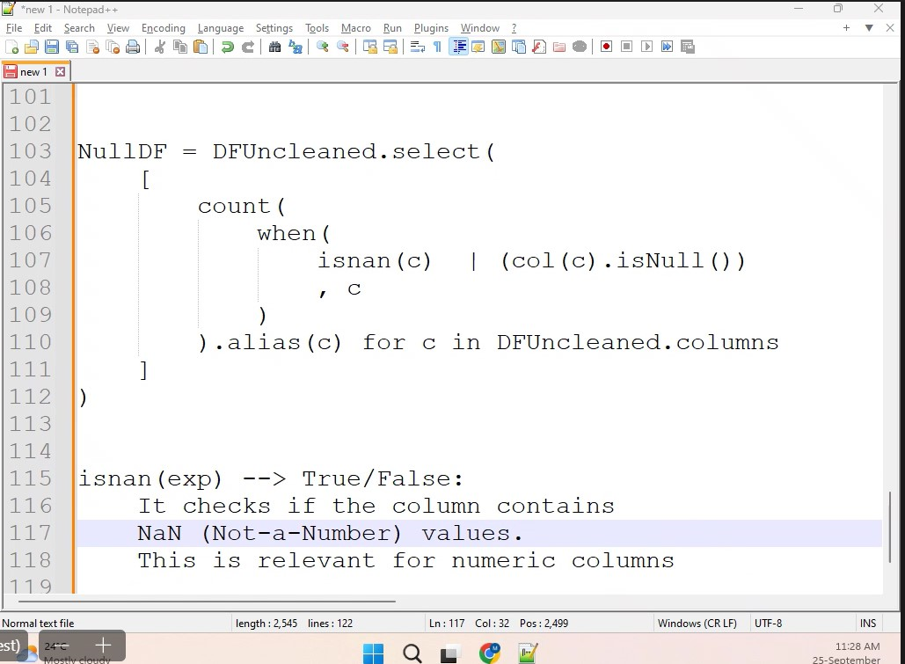
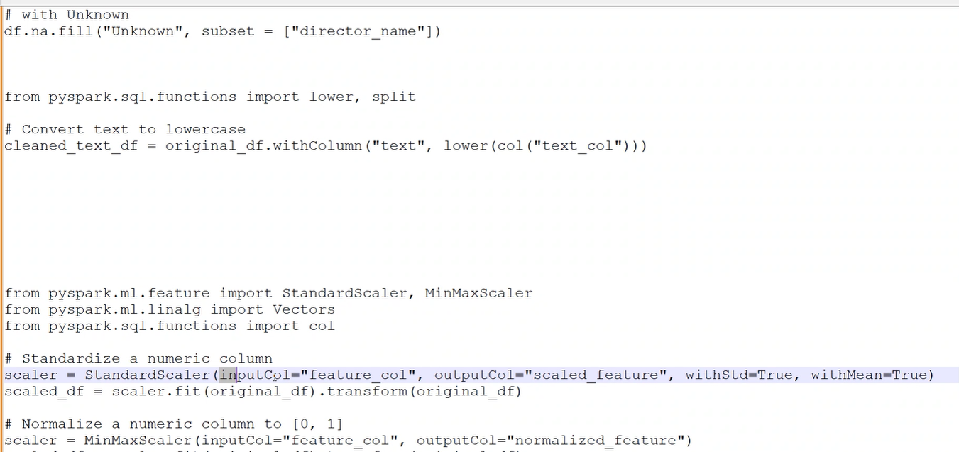
Day – 1 ( continued… )

Slide 5
Day – 2 ( Data Bricks - 1 )
1. Unified Analytics: Databricks offers a unified platform for data teams to collaborate on big data and machine learning projects.
2. Apache Spark Integration: It seamlessly integrates with Apache Spark, simplifying cluster management for data processing.
3. ML and AI: Databricks supports machine learning with MLflow, Delta Lake for data management and deep learning libraries.
4. Scalable Collaboration: It provides scalability for large datasets and collaborative features like shared notebooks and dashboards for team collaboration.

Slide 6
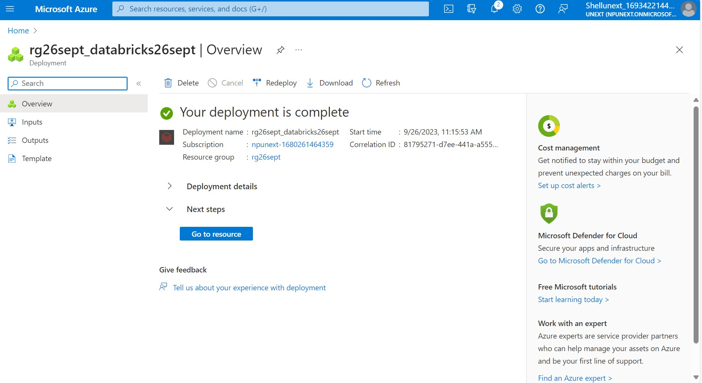
Day – 2 ( continued… )
Creation of DataBricks

Slide 7
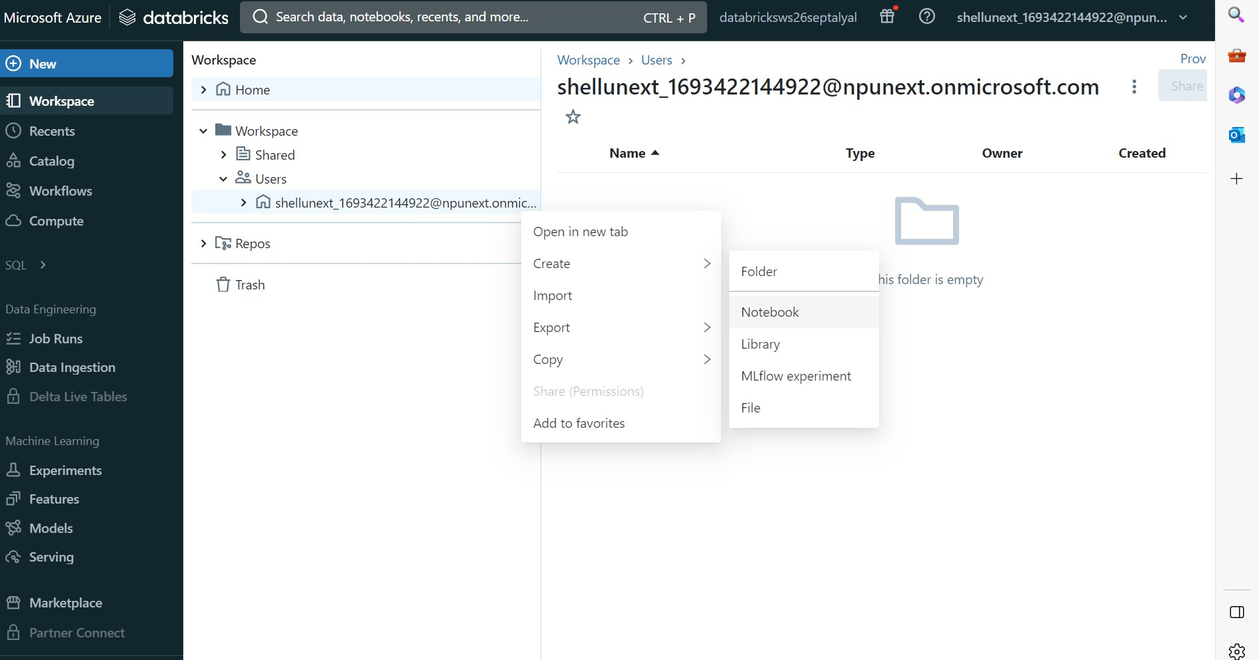
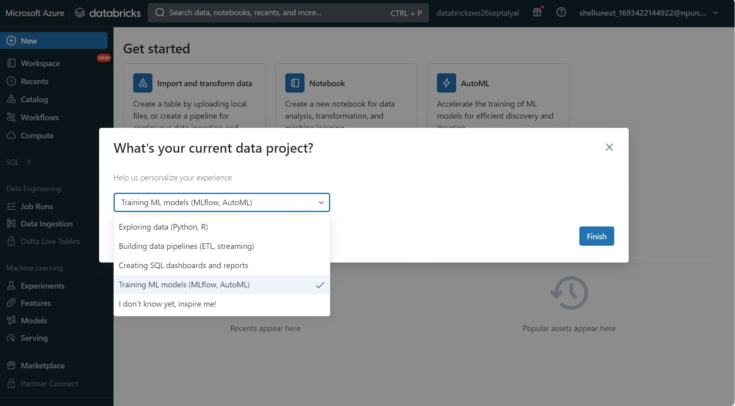
Day - 2 ( continued…)
Creation of Notebook in Databricks workspace

Slide 8
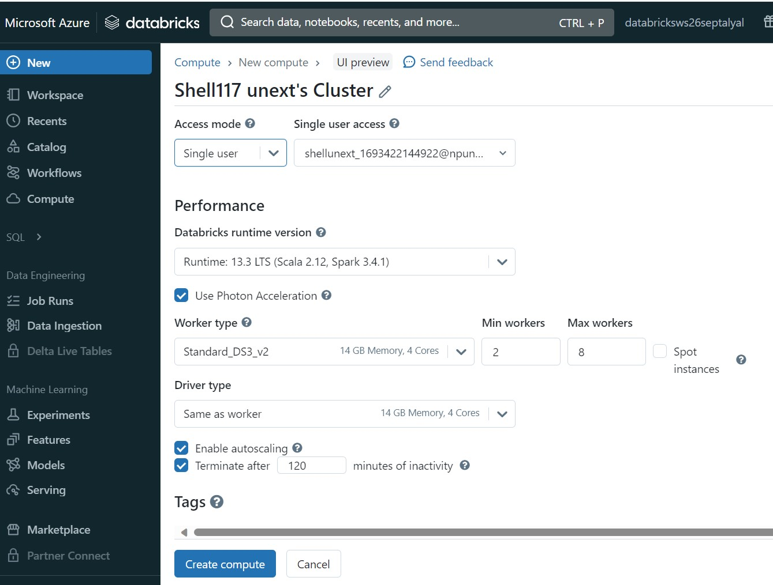
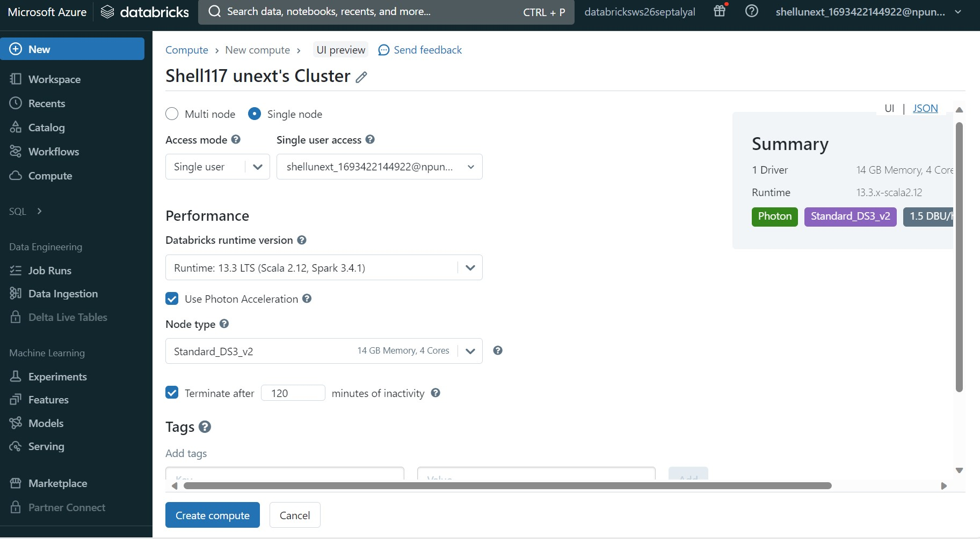
Day – 2 ( continued… )
Creating Single Node and Multiple Clusters in order to connect with the workspace.

Slide 9
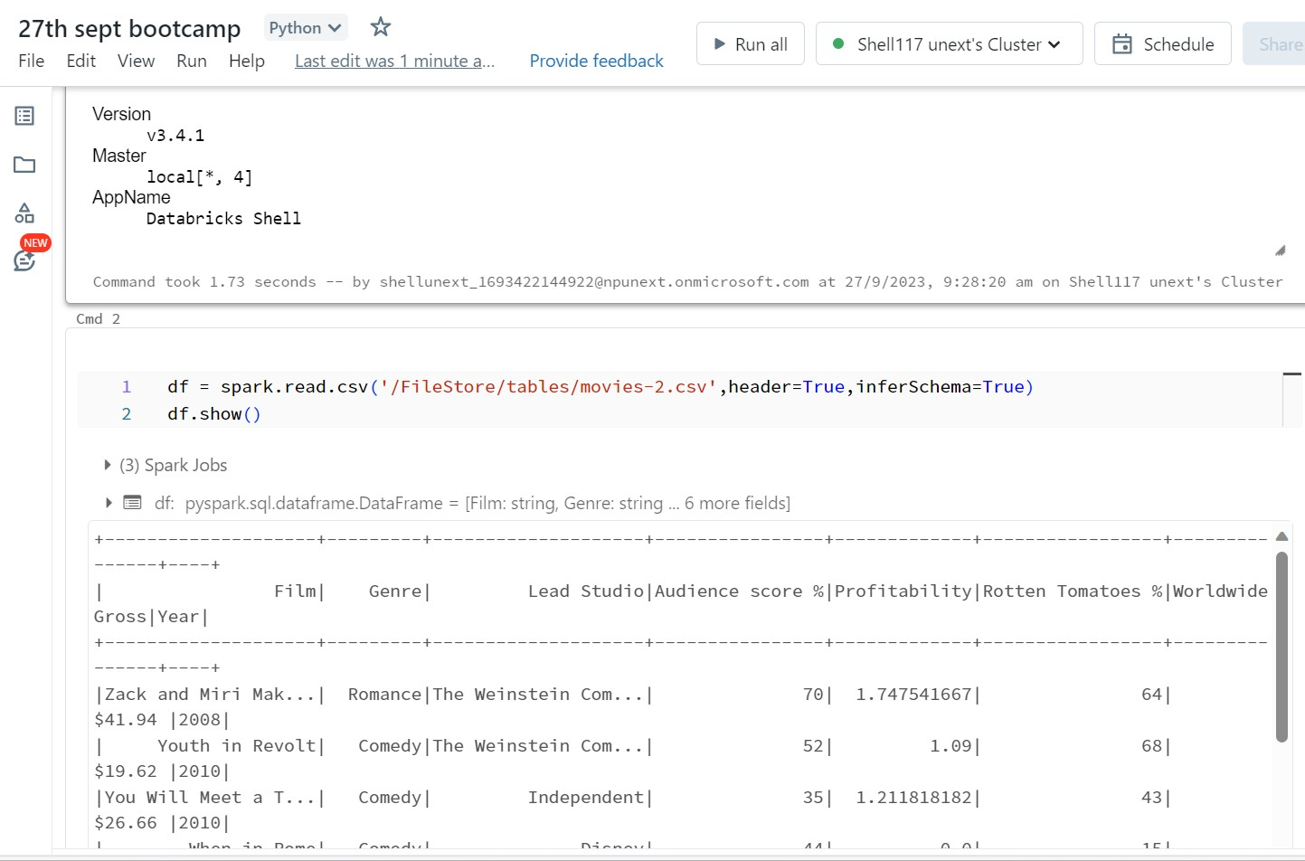
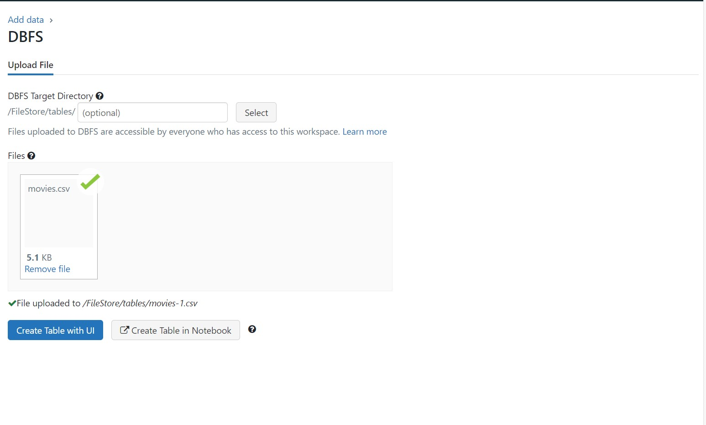
Day - 3 (Data Bricks - 2 )
Data ingestion through DBFS Functionality in the Databricks
Reading file through Spark . Making the DataFrame

Slide 10
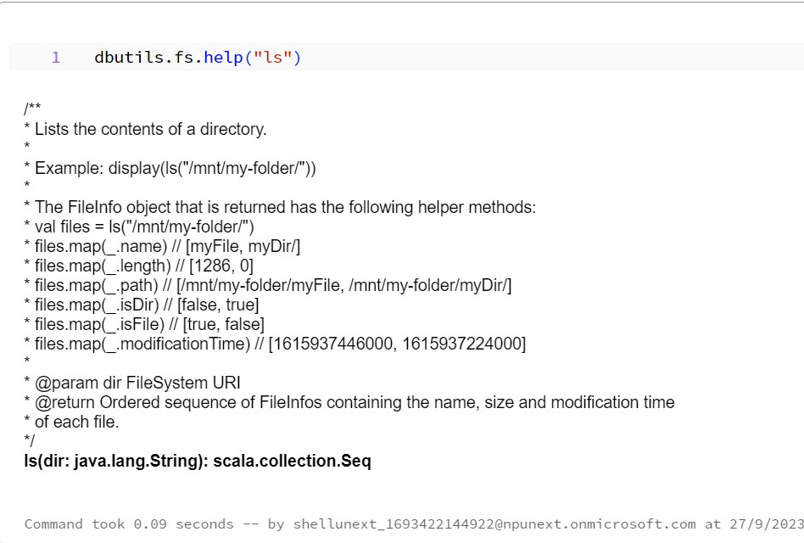
Day - 3 ( continued…)

Slide 11
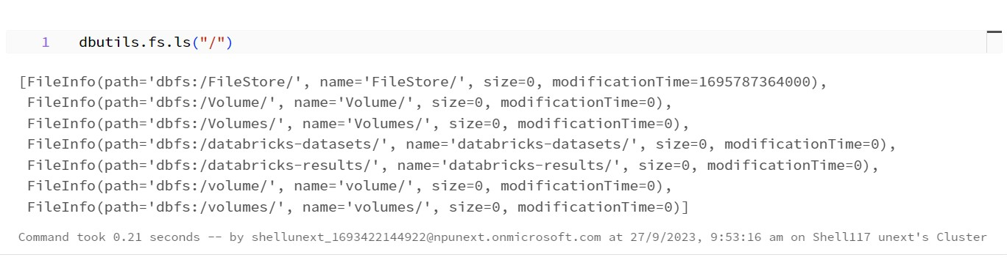
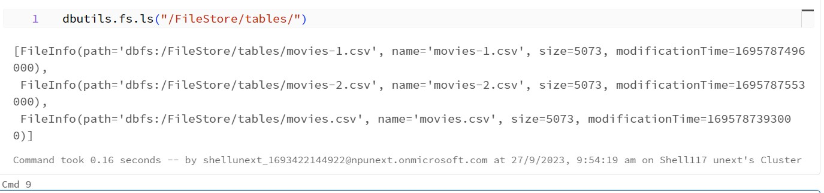
Day - 3 (continued…)
The image depicts the list of files in the filesystem.
This command lists the tables in the File Store

Slide 12
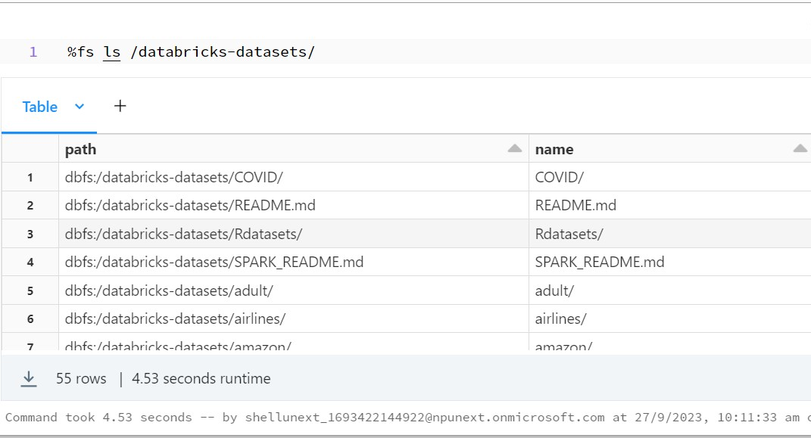
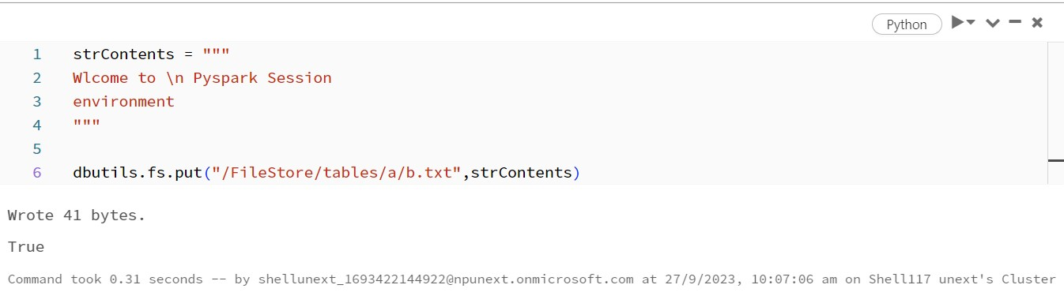
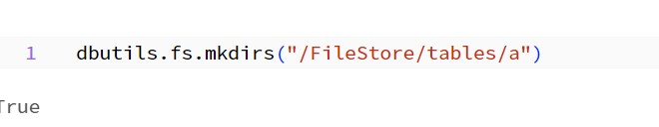
Day - 3 (continued…)
List of Datasets in data bricks File System
Writing some textual contents and putting it into the .txt file
Creation of a directory named ‘a’

Slide 13
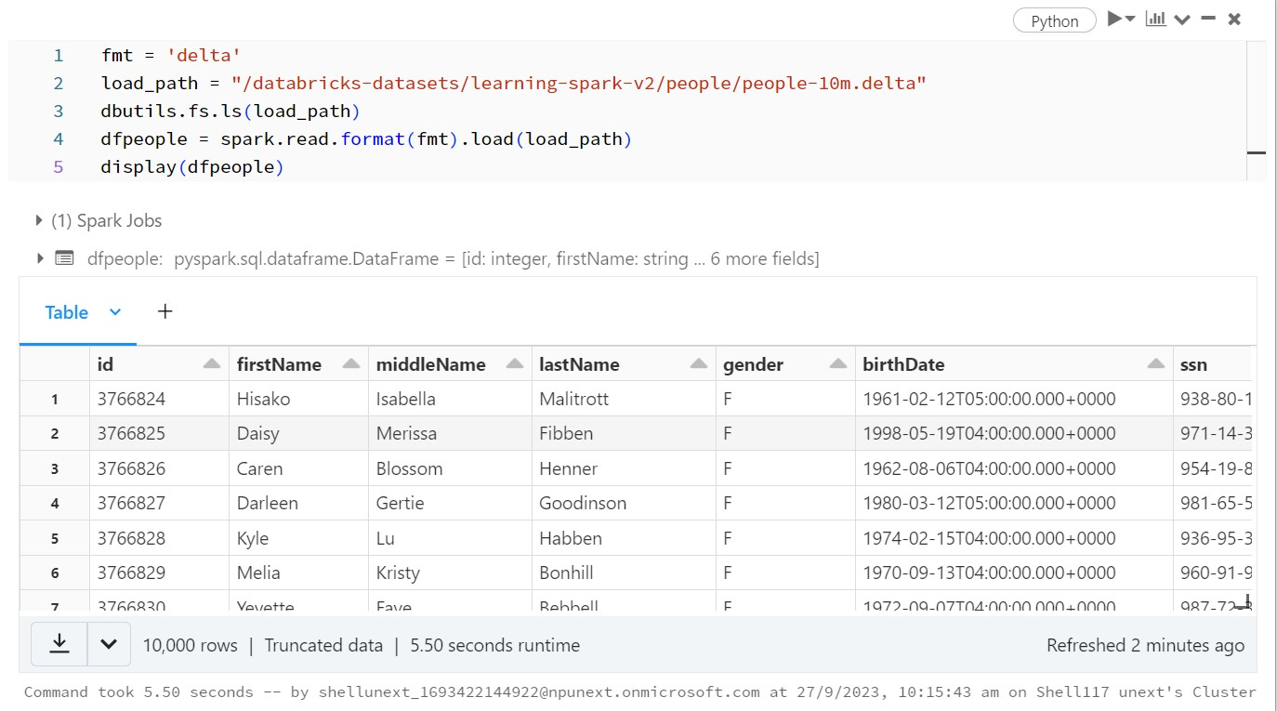
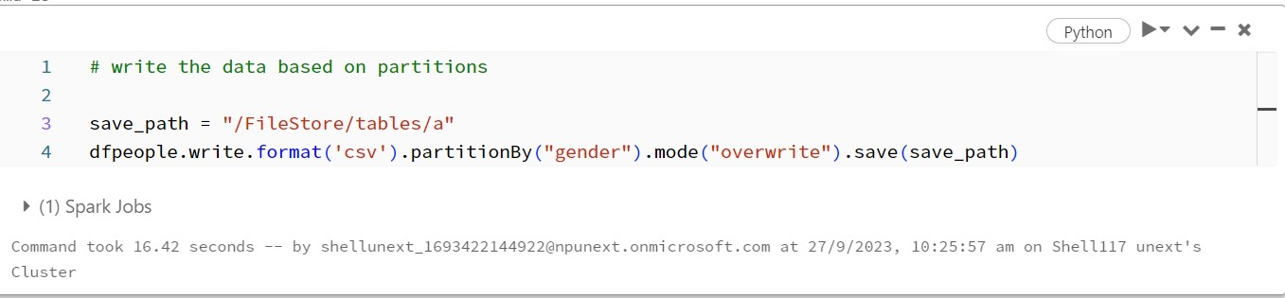
Day - 3 (continued…)
Reading the file which is inherently having the delta format in databricks
Then in the second image partitioning dataframe by gender column is present in the dataset.

Slide 14
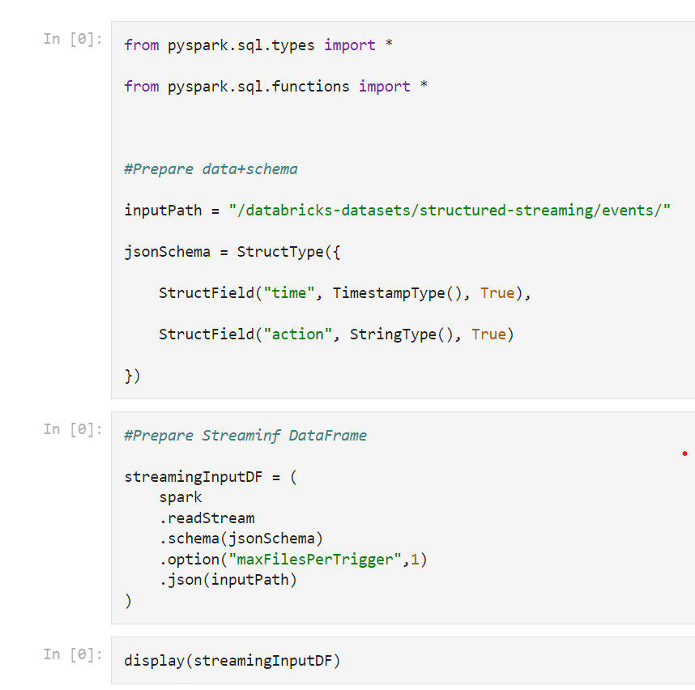
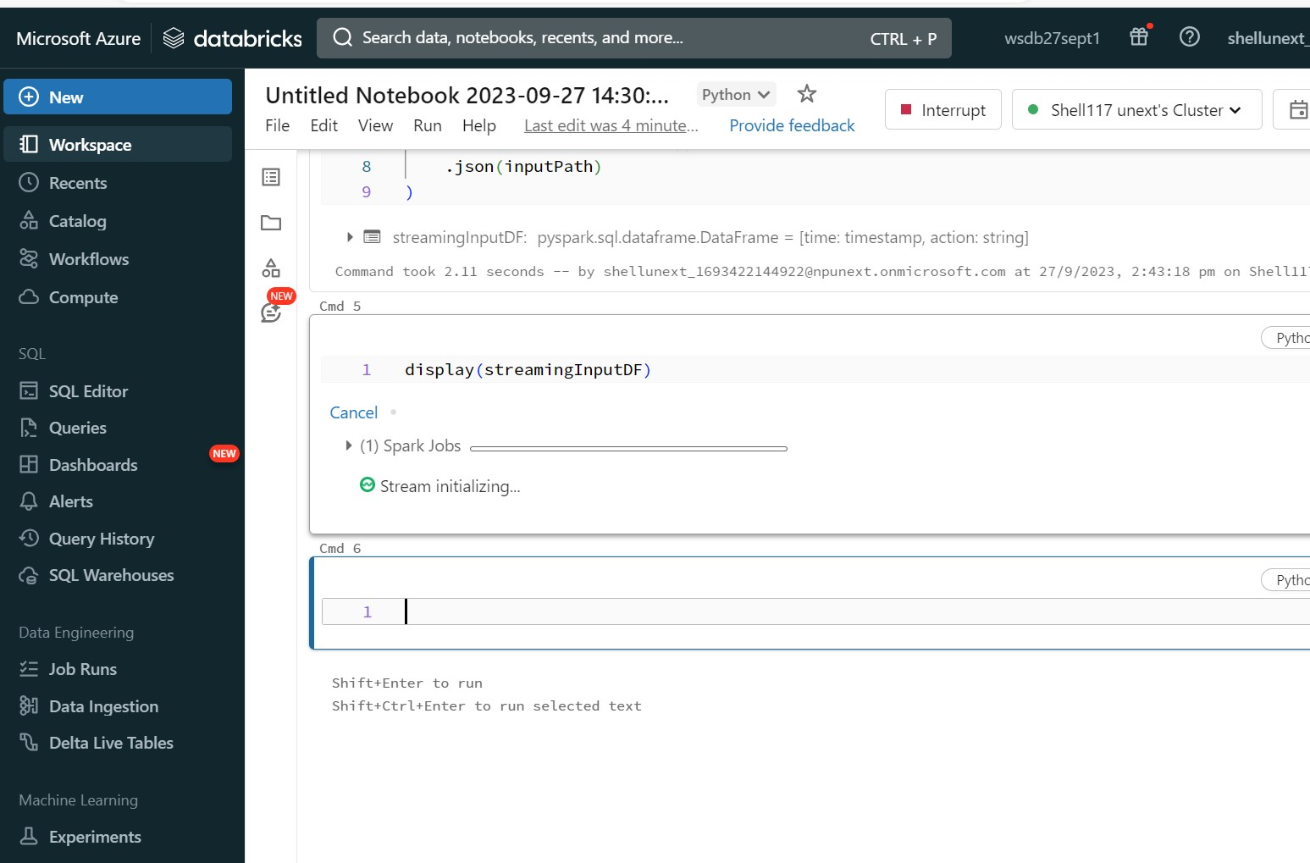
Day - 3 (continued…)
Streaming Data through Databricks using timestamp.

Slide 15
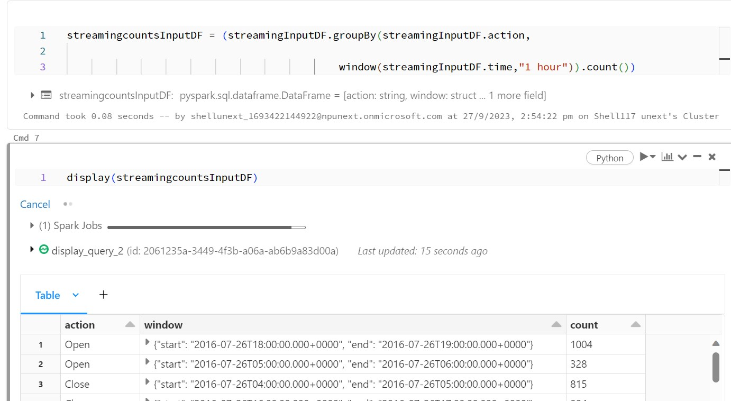
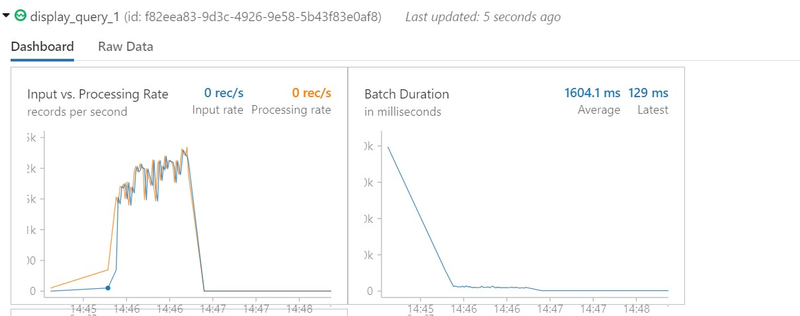
Day - 3 ( continued…)
Graphical representation of Streaming of data through the dashboard of Databricks.
The above image depicts the group by of the streaming data frame by action for an hour in order to find no of counts of action in a window of 1hour.

Slide 16
Day - 4 ( Azure Containers )
Containerization: Docker is a containerization platform that allows applications and their dependencies to be packaged and run consistently across different environments.
Portability: Docker containers are lightweight and can run on any system that supports Docker, making applications easily portable.
Efficiency: Docker optimizes resource utilization, making it efficient for running multiple containers on a single host.
Ecosystem: Docker has a rich ecosystem of tools and services, such as Docker Compose and Docker Swarm, for container orchestration and management.

Slide 17
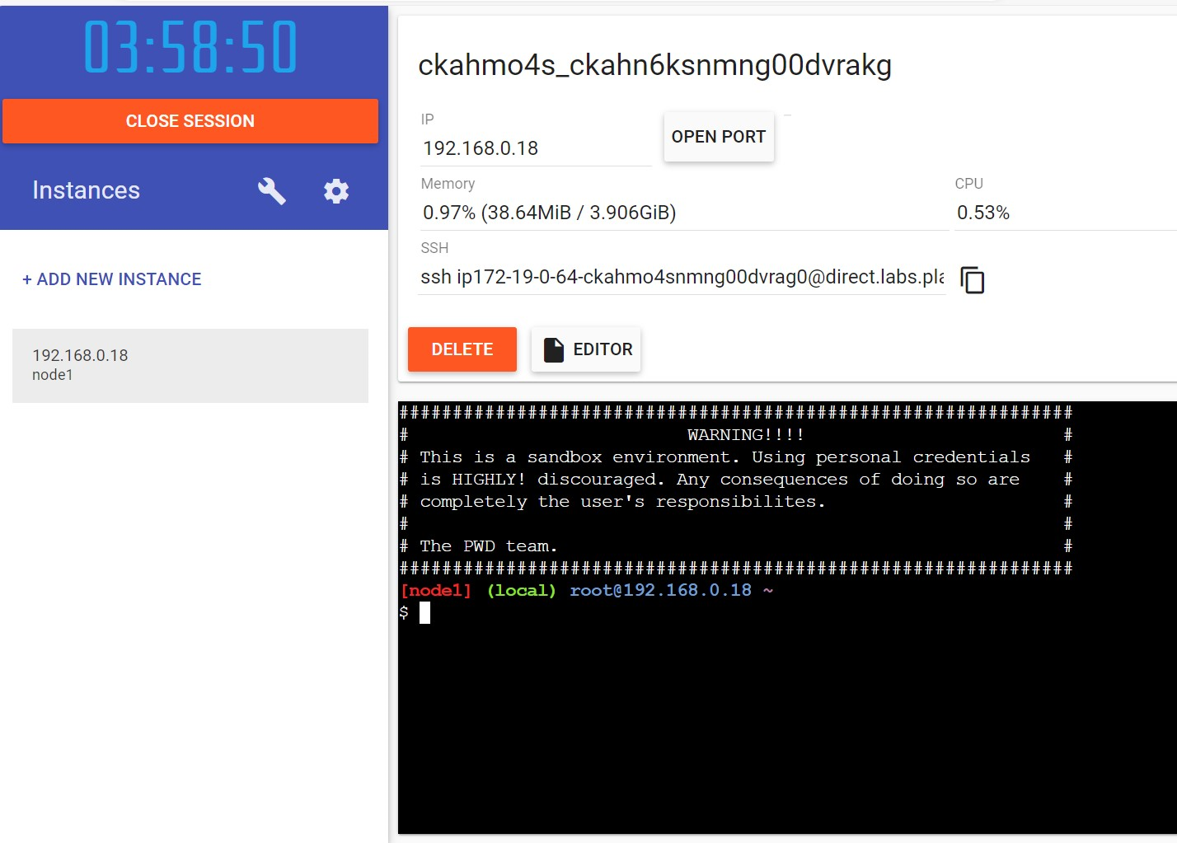
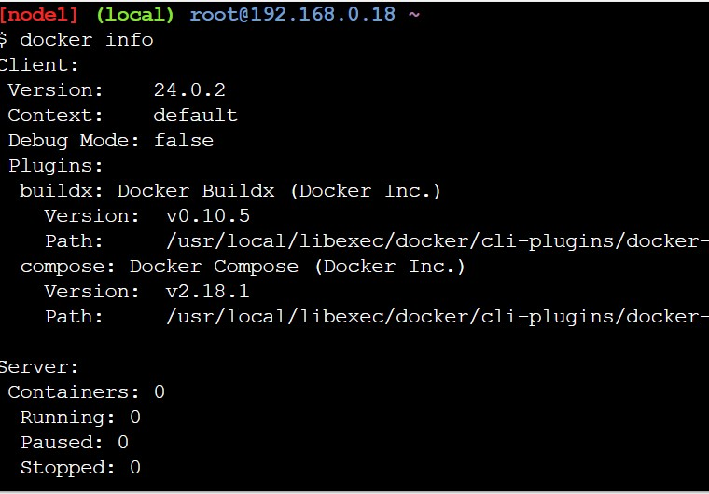
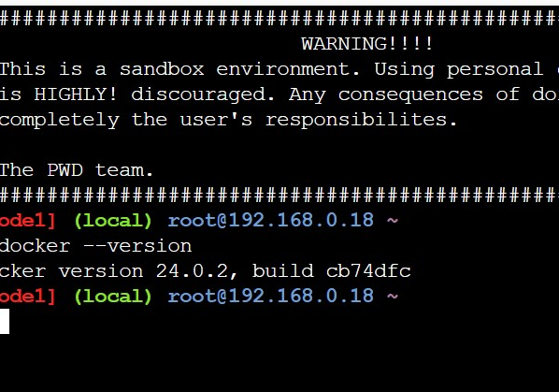
Day - 4 ( continued…)
Brief introduction of Docker and Some Docker CLI commands

Slide 18
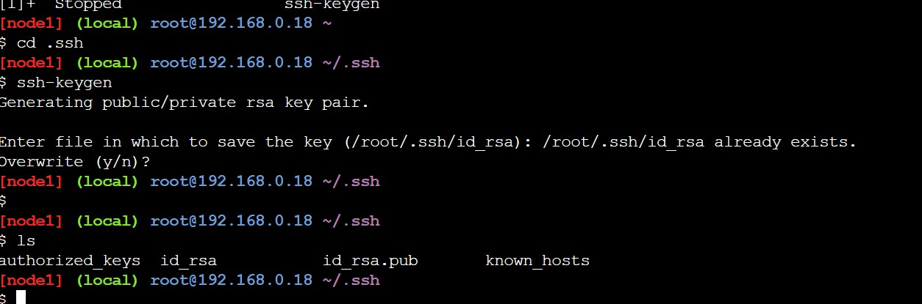
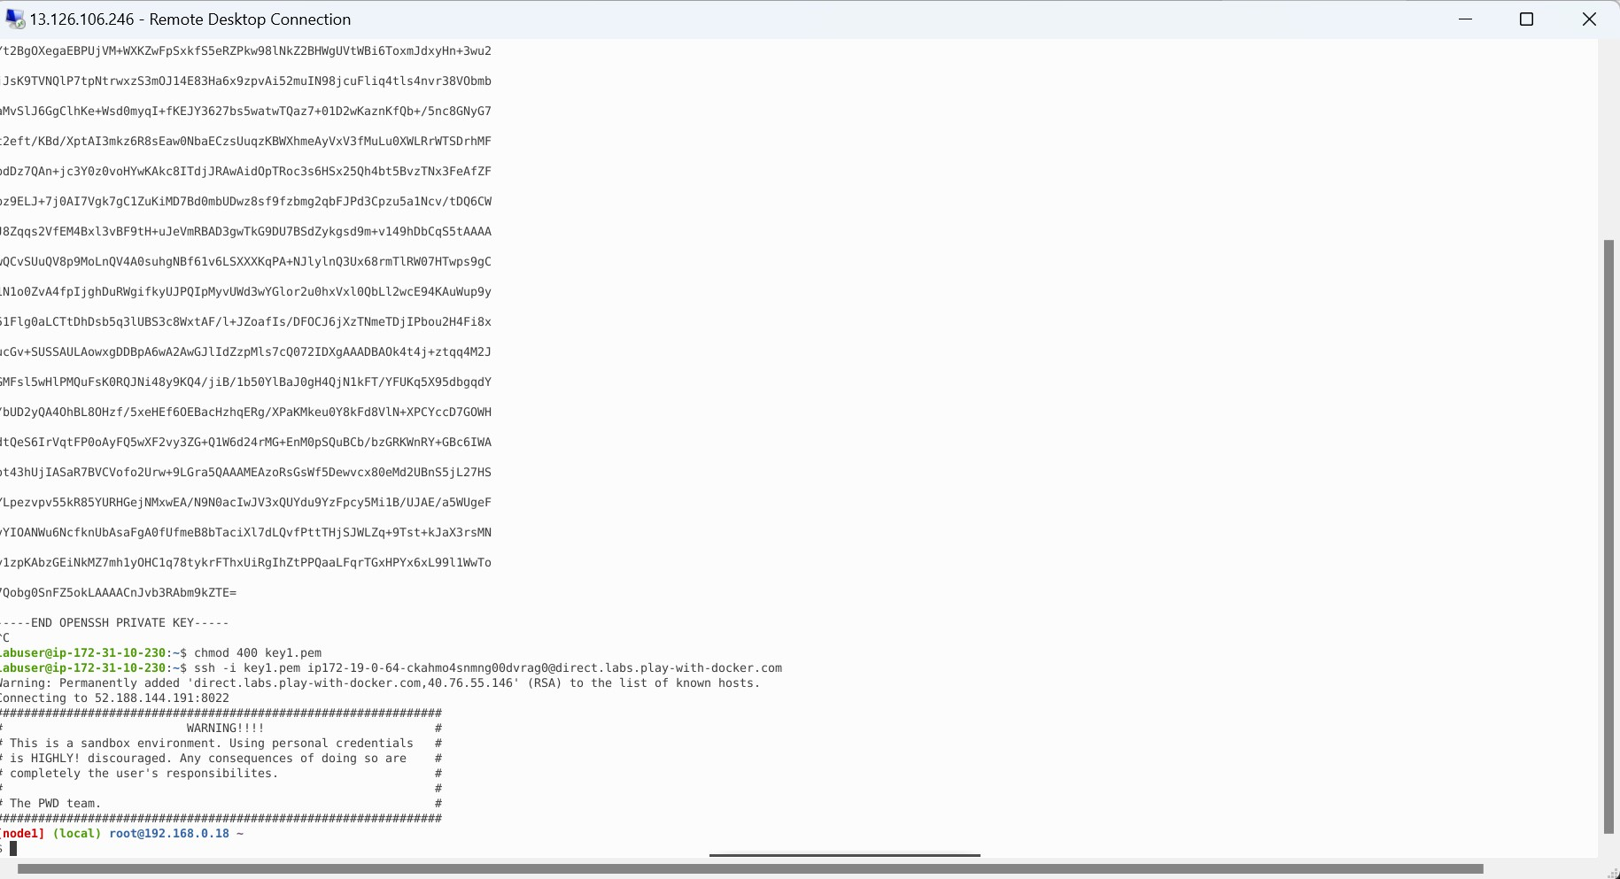
Day - 4 ( continued…)
Creation of key and lock pair and executing in the Virtual machine which is depicted in the last image

Slide 19
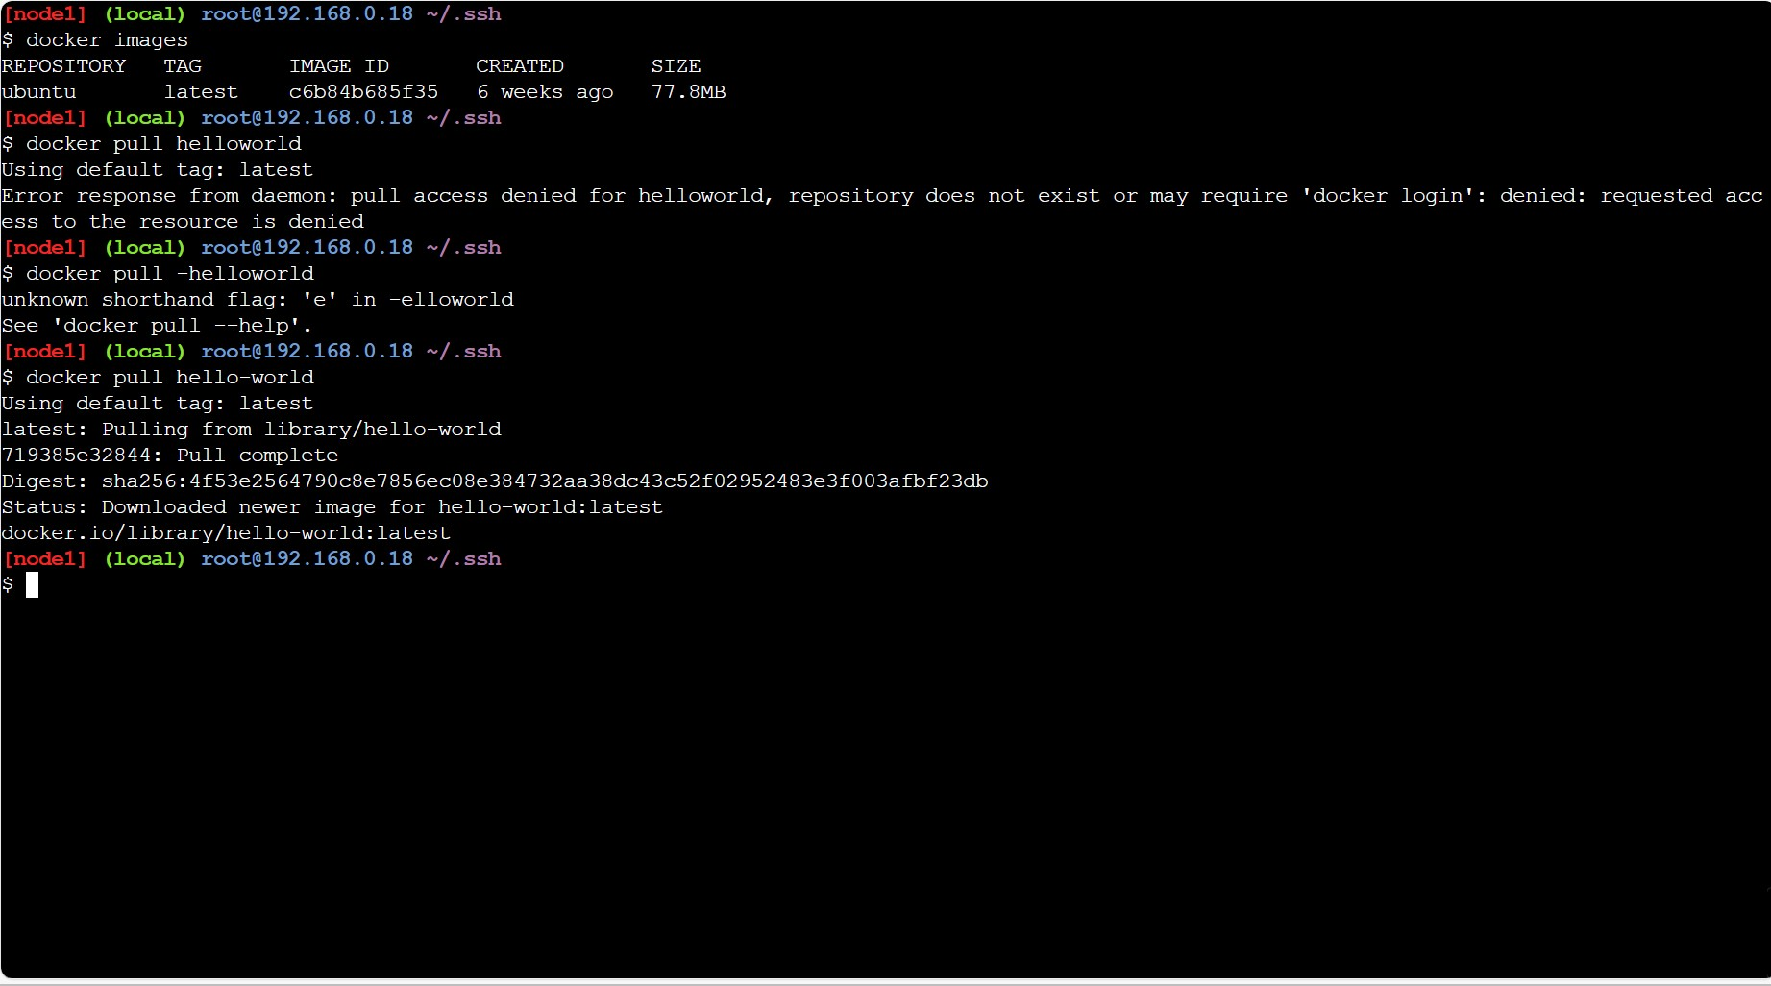
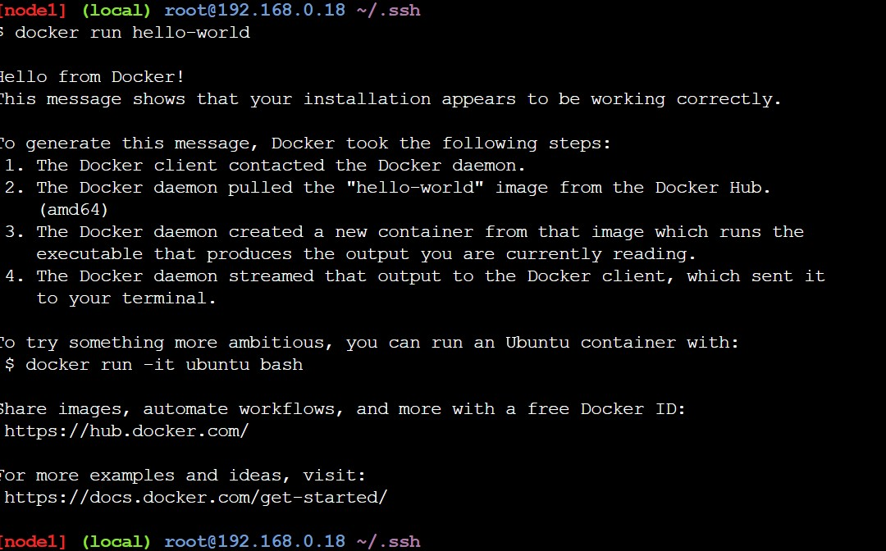
Day - 4 ( continued…)
This image shows the docker pull.
This image shows the run of the image after pulling

Slide 20
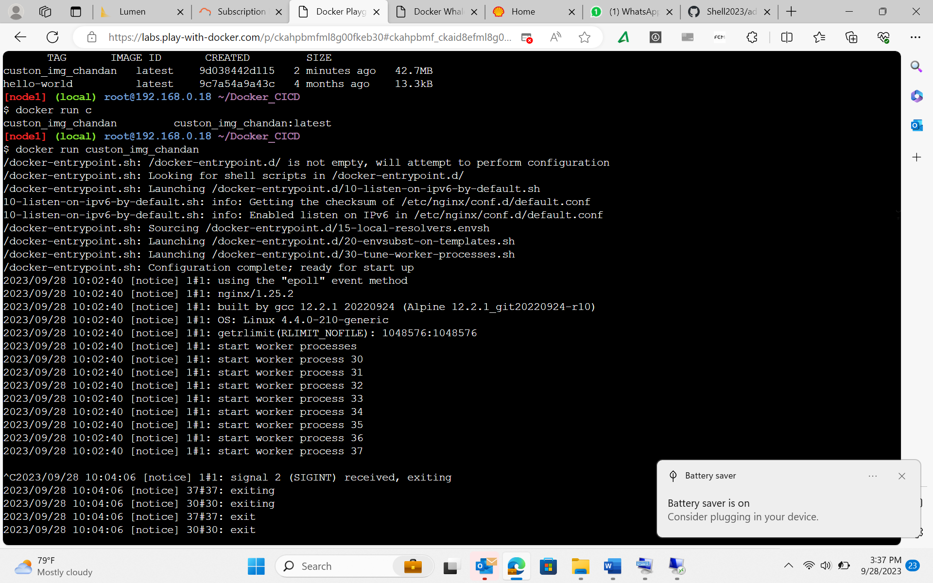
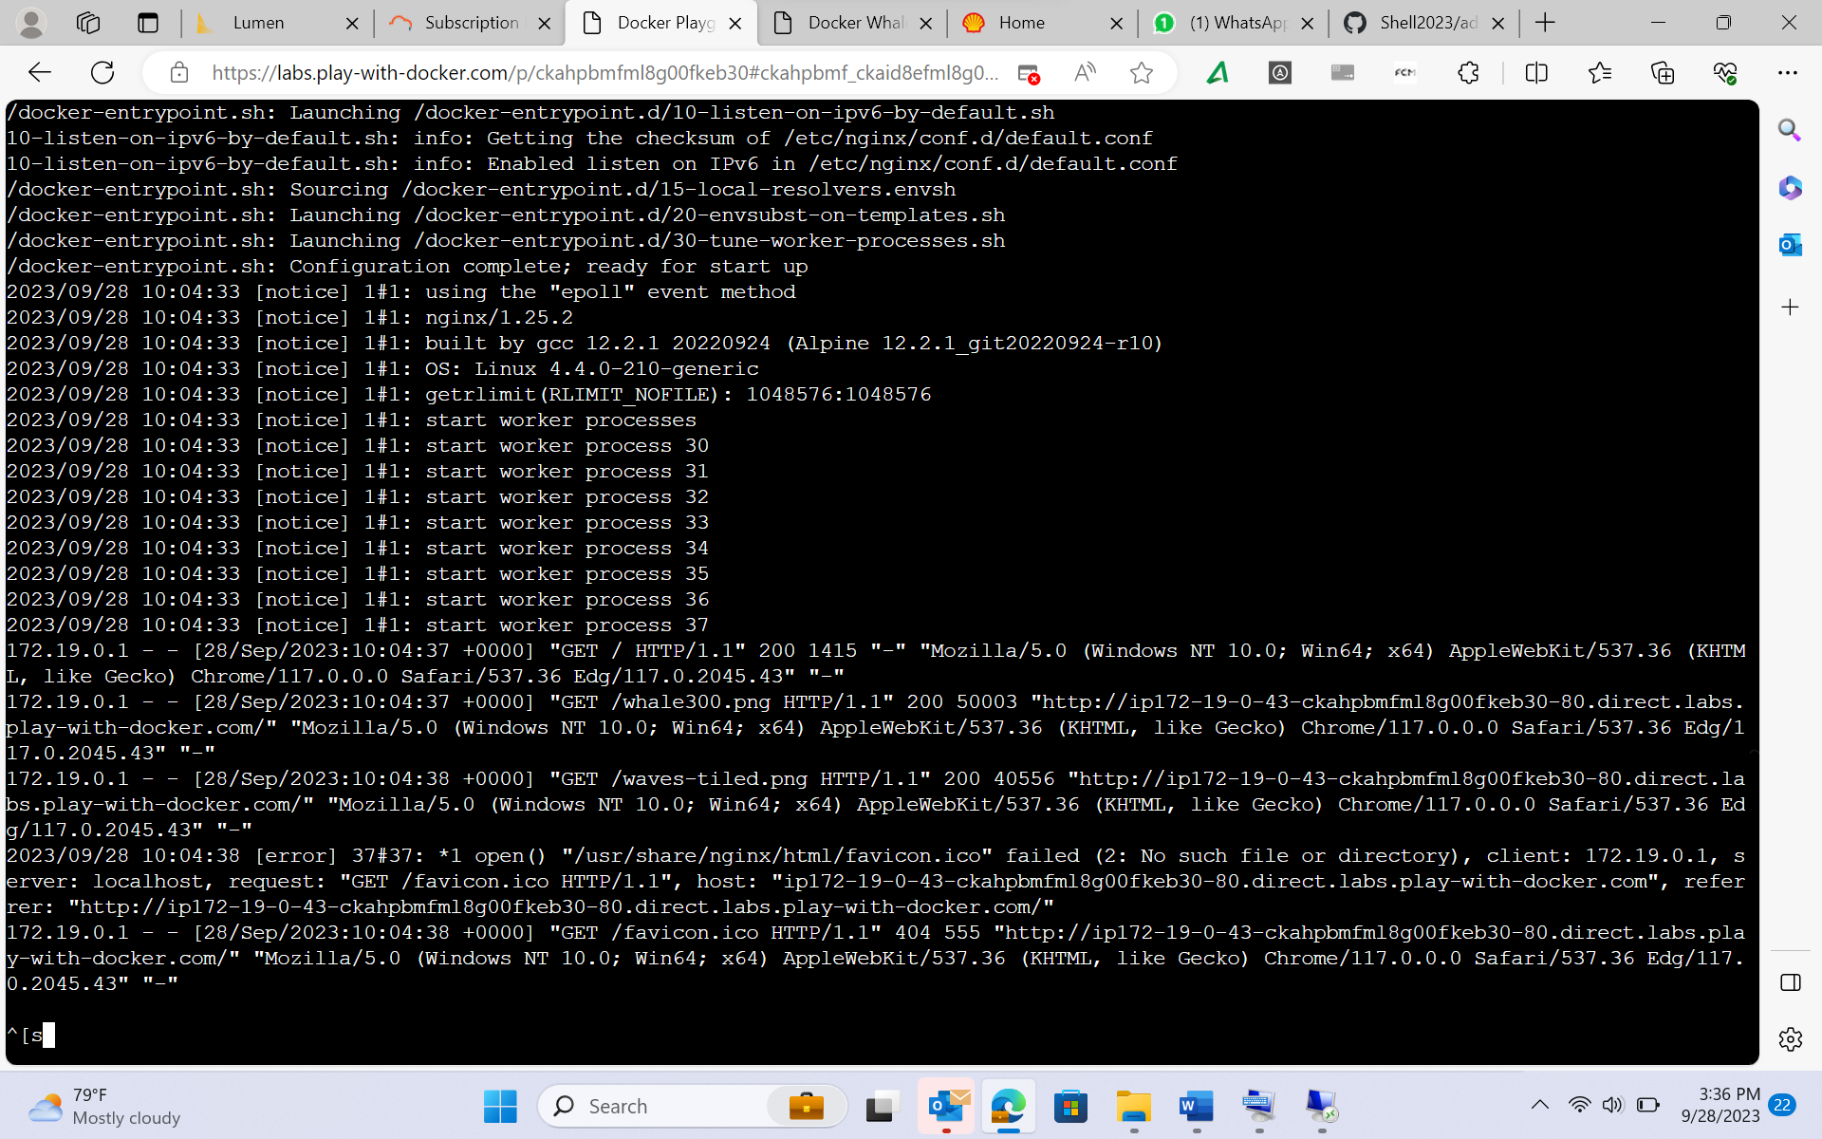
Day - 4 ( continued…)
Running the docker image to deploy an html page.
The request response message on accessing the deployed page on localhost

Slide 21
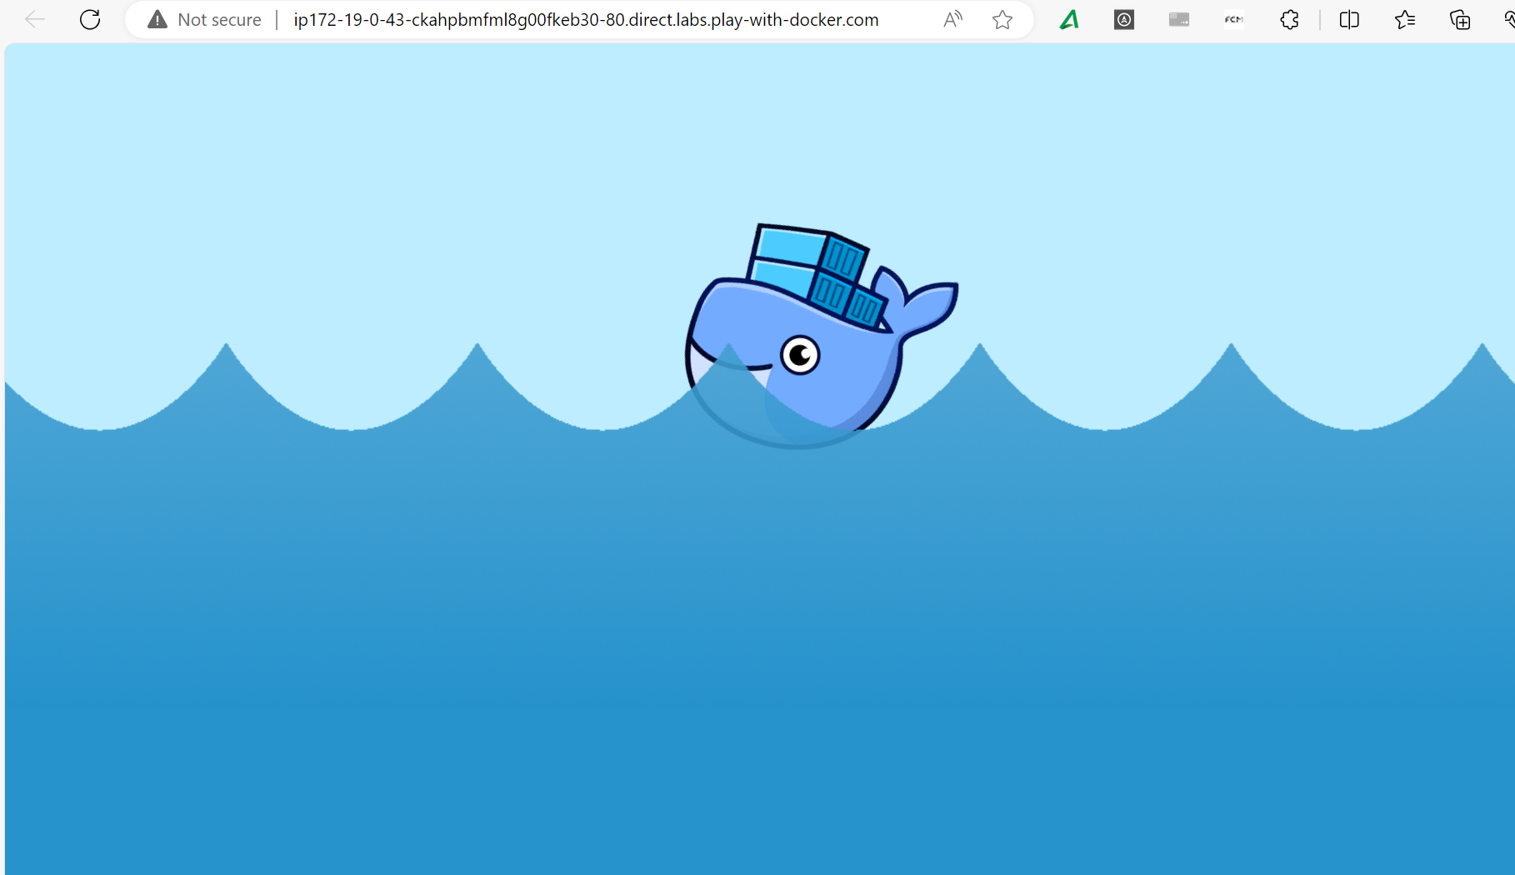
Day - 4 ( continued…)
The deployed page on running the docker image

Slide 22
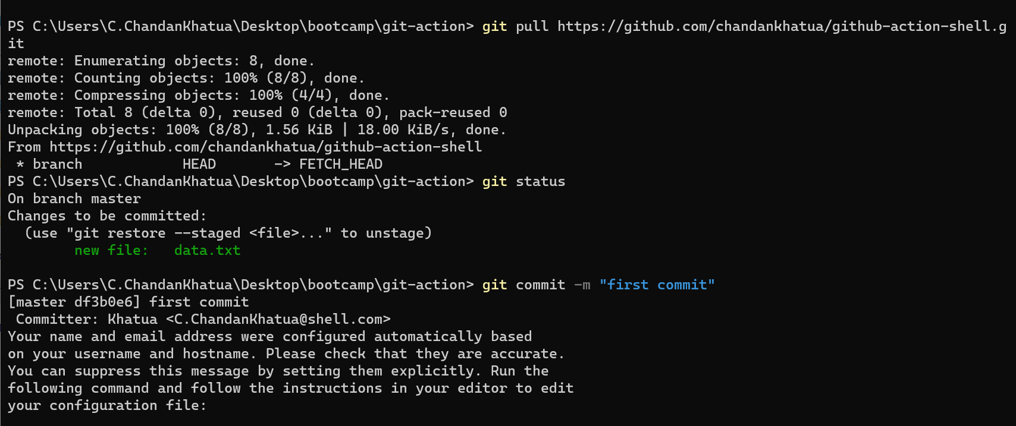
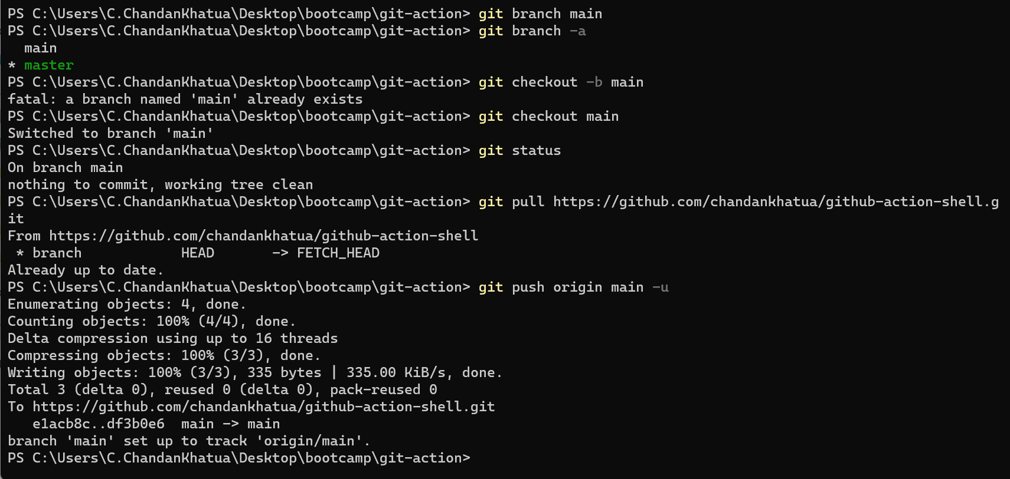
Day - 5 ( Azure Devops )
Git commands like git add , git commit , git push , git pull , creating a new branch

Slide 23
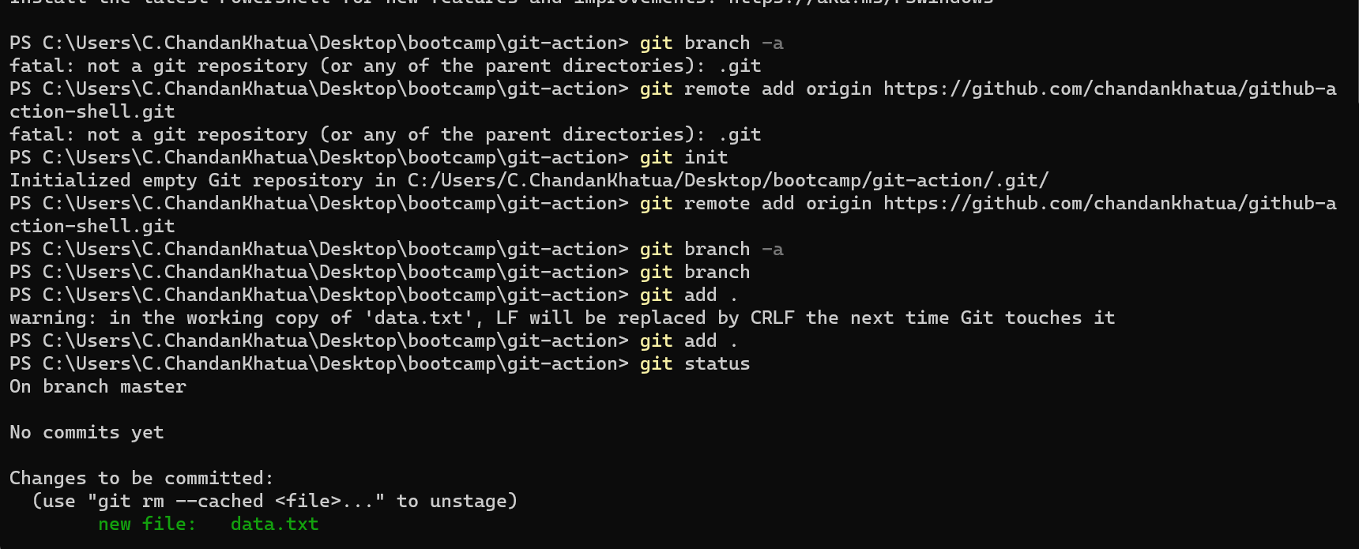
Day - 5 ( continued… )
Git commands like git add origin , git push a new branch

Slide 24
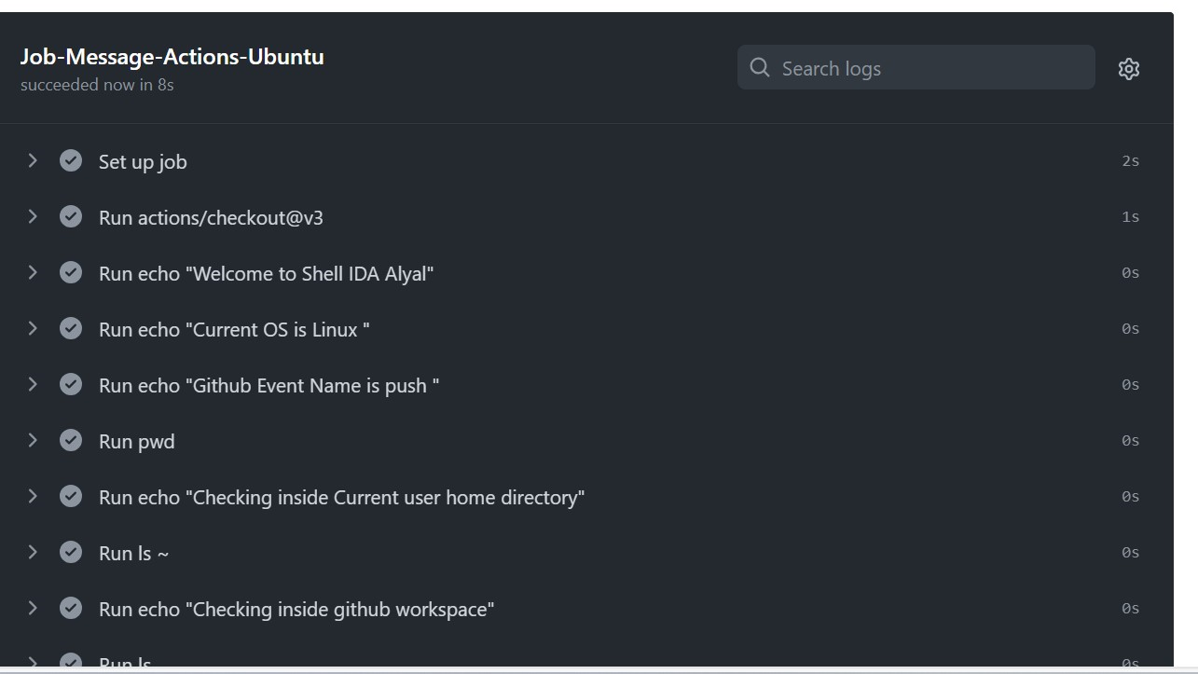
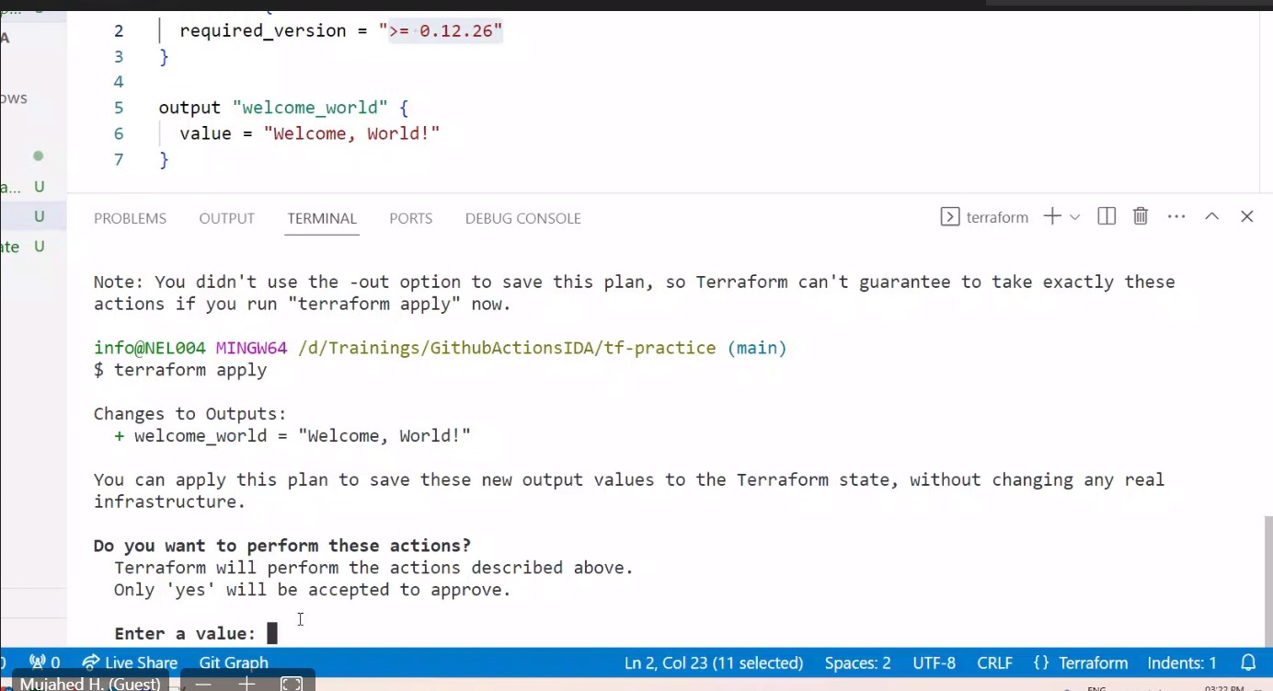
Day - 5 ( continued… )
Revisiting git actions and having some Terraform Hands on.

Slide 25
Thank you

